Slide 1
Kensho Blue - Milestone 1
Brian Lin
Shane Ong
Cory Williams
Matteo Zhang

Slide 2
Problem Statement
Knowledge Graph
Toyota
20th century
Apple (company)
Founded in
Founded in
Ki Nam Kim
produces
produces
competes with
CEO of
Headquartered in
produces
Vehicles
Smart Phones
Samsung
Located in
Japan
Mount Fuji

Slide 3
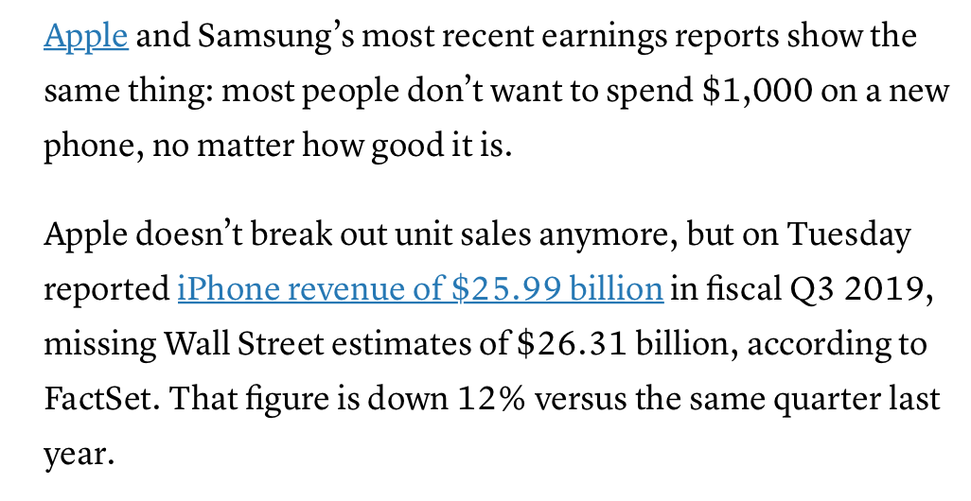
Problem Statement
NLP
Apple (company)
Figures down 12%
produces
competes with
produces
Smart Phones
Samsung
Notes:
Develop relevant knowledge graph
Train graphical NLP models using named entity recognition, named entity disambiguation, and named entity linking.
These will require connecting to the knowledge graph

Slide 4
Team & Collaboration Infrastructure
Centralized GitHub repo set up in the cookiecutter data science project template for submission
Local host on Matteo’s laptop for day-to-day collaboration
May request for additional resources if necessary

Slide 5
Literature Review (Traditional Approach)
3 Steps in a traditional entity framework
1: Name Mention Identification: Named Entity Recognition (NER)
Stanford NER tagger is the standard in NER
2: Candidate Entity Selection - Name Variation Problem
3: Local Compatibility Computation - Name Ambiguity Problem
Guo et al. (2011) graph-based entity linking method
Select the candidate entity with the highest degree
Notes:
Candidate Entity Selection - this is where the name variation problem comes in, Apple, Apple Inc., AAPL
We focus on methods that employ knowledge graph instead of knowledge base
One problem with the traditional approach is that this system relies heavily on Local Compatibility Computation, which is limited by the weakness of feature engineering in incorporating the contextual evidence (Deng et al. 2018).

Slide 6
Literature Review (Neural Network)
Encoding contextual evidence for entity linking using Neural Network
Most of the literature based on knowledge base
Knowledge graph can be represented as (Cetoli et al. 2018):
List of triplets (xi,ei,j,xj)
Embeddings from Graph Convolutional Network (GCN)
Joint model yield better performance than a pipeline of individually trained models (Singh et al. 2013)
Notes:
Attention mechanism to reweight
Combined with embedding for input text for the final output
joint model for entity tagging, coreference resolution and relation extraction can yield much better performance than individually performing each on a pipeline

Slide 7
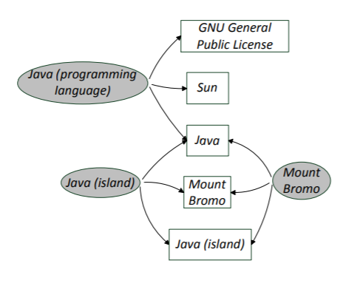
Project Ideas
Focus on Graph-based Named Entity Disambiguation
Use Wikidata triplets to construct knowledge graph of all entities mentioned within text, across specified local word span
Explore graphical distance/similarity metrics to disambiguate entities
“Mount Bromo is one of Java’s most popular tourist attractions”
Notes:
https://pdfs.semanticscholar.org/d7fb/58dd433645c245be2d38d60262894a8d232f.pdf?fbclid=IwAR1p9_N-XKFAvYgotkDk8FNc2MYGU6I20ByvlfdSLJiOGIQbXdOJ3A1KMFk

Slide 8
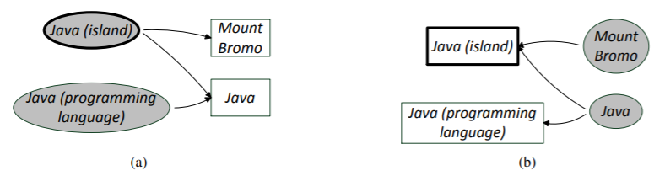
Project Ideas
Baseline: Compute number of direct connections and select entity with highest degree
Explore: Other graphical distance/similarity metrics, Graph Convolutional Network and/or other deep learning graphical methods
Good-to-have: Complete the information extraction pipeline by exploring coreference resolution

Slide 9
Learning Goals
Read up on various graphical distance/similarity measures for disambiguation task
Explore possibilities of deep learning approaches in graph-based NED

Slide 10
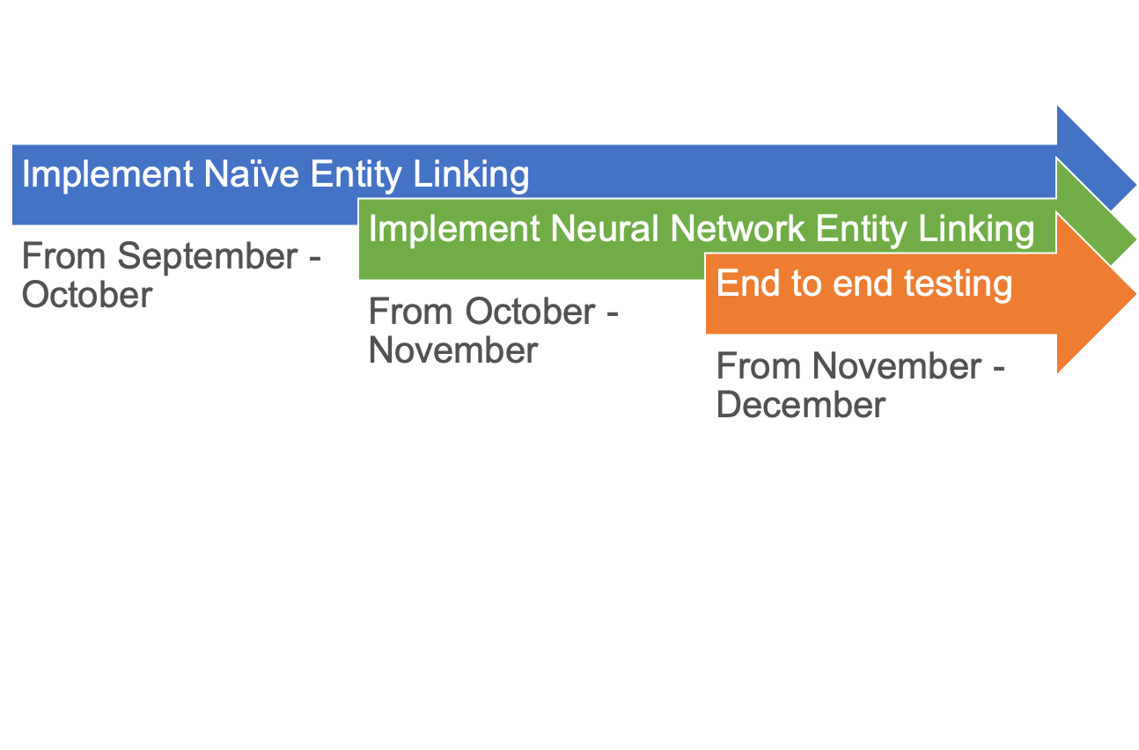
Scope of Work
Timeline

Slide 11
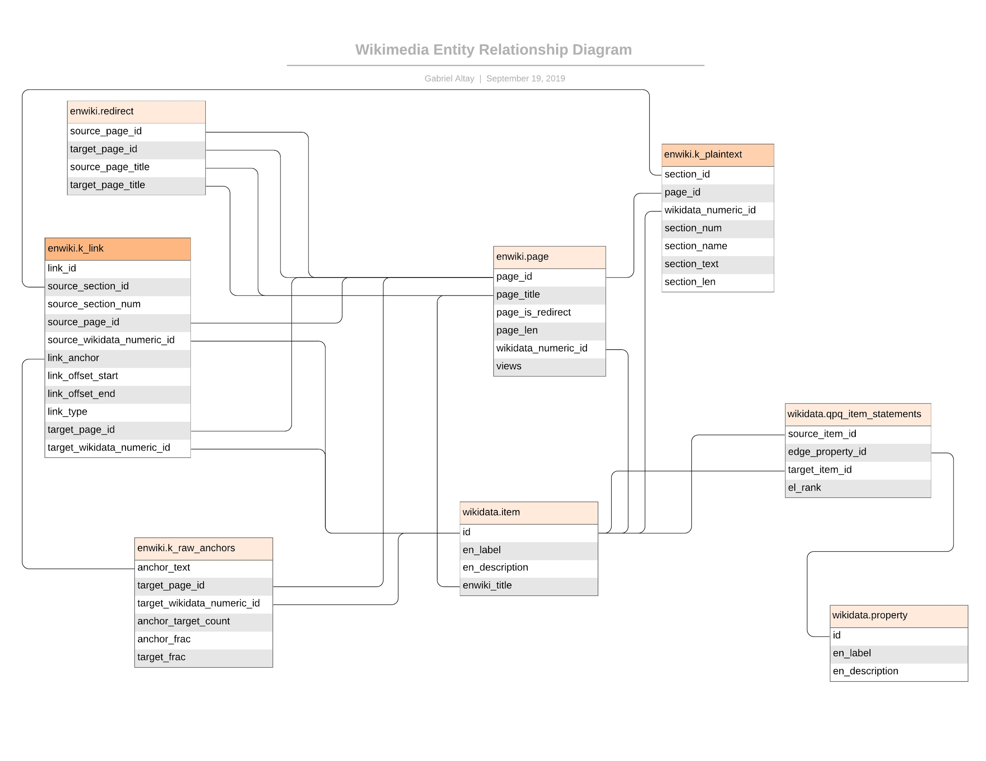

Slide 12

Summary Statistics
Wikidata
383.2 million triples
58.7 million entities
6490 different type of relations
Wikipedia (English)
14.7 million pages
8.8 million redirects
5.9 million unique pages
135 million links to other Wikipedia pages
7.8 million unique (anchor_text, target_page) pairs

Slide 13
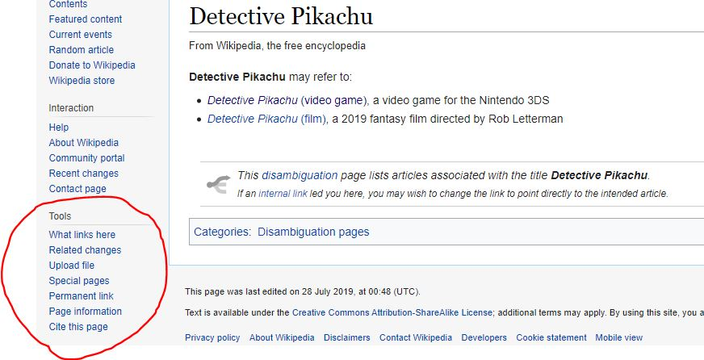
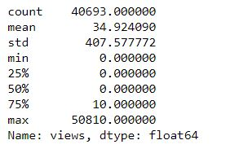
EDA: Missing Wikidata Entities
40693 Wikipedia pages with no corresponding Wikidata item

Slide 14
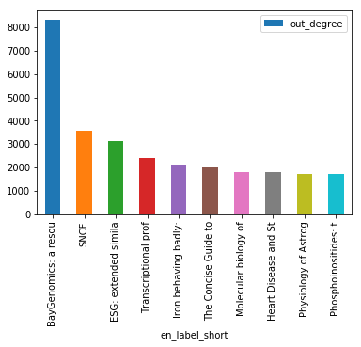
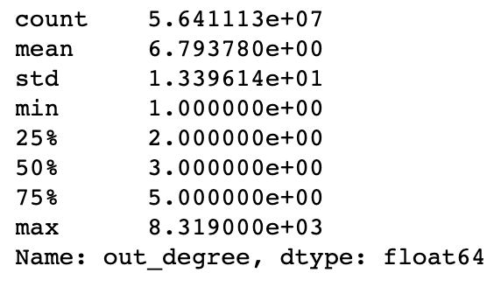
EDA: Top Outdegree Centrality Entities

Slide 15
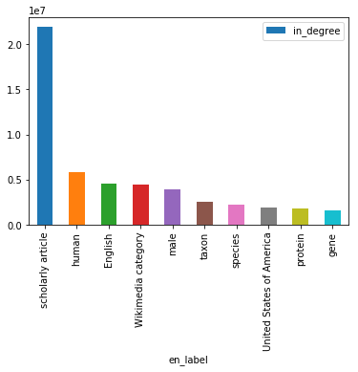
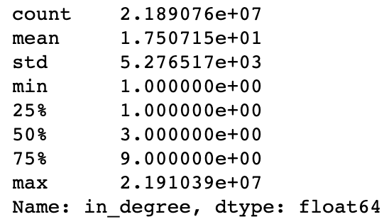
EDA: Top Indegree Centrality Entities

